Slide 1

Legal Data Analysis
Final Project
HEC PARIS
2024
A. Gourdain, P. Finck, P. Seigneuret, J. Le Bret

Slide 2
Plan
Our Topic and its legal context
Our Code
Difficulties encountered
Results and conclusions

Slide 3
A. Our Topic
Topic Context, Research Question, Data availabilty

Slide 4
What are the chances of winning an appeal against a tax mark-up (penalty) for abuse of law ?

Slide 5
Legal Context
Law of October 23, 2018 relating to the fight against fraud (following the trauma of the Cahuzac case)
Article L. 228 of the Book of Tax Procedures
Automatic transmission of the case to the public prosecutor (i.e., criminal authority) if > 100,000 € and:
100% penalty for opposition to a tax audit
(Article 1732 of the Tax Code)
80% penalty for abuse of law (Article 1729 of the Tax Code)
40% penalty for deliberate failure if application of the 100%, 80%, or 40% penalties or a complaint within the preceding 6 years

Slide 6



Data availability and phased approach
Scrapping the website: https://opendata.justice-administrative.fr/
Creation of the dataframe
Topic Modelling and Results

Slide 7
B. Our Code
Steps and choices

Slide 8

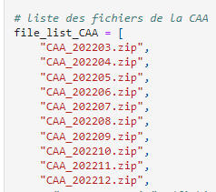
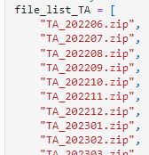

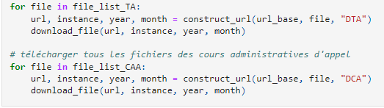
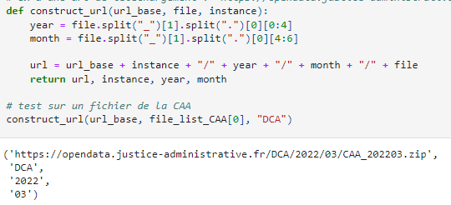
Importing Data
https://opendata.justice-administrative.fr/
List → Urls → Download

Slide 9
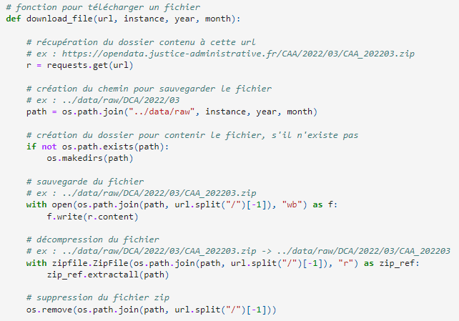
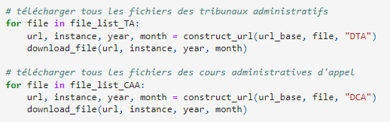
Importing Data
https://opendata.justice-administrative.fr/
List → Urls → Download

Slide 10
Importing Data
https://opendata.justice-administrative.fr/
We have downloaded all the open data concerning the TA and CAA (Administrative Courts and Courts of Appeal)
300 000 court decisions to categorise
DTA/ORTA or DCA/ORCA, we need to sort !

Slide 11
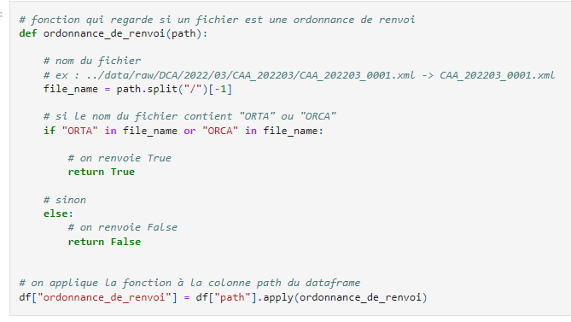
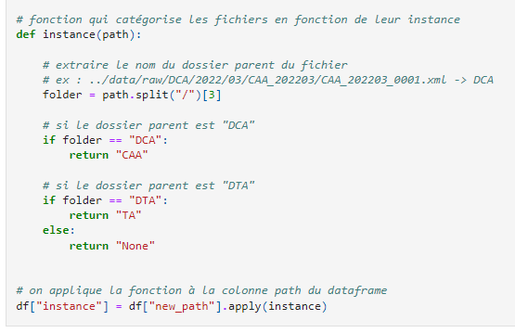
Are there a lot of referrals ?
Identify referrals
Categorise

Slide 12
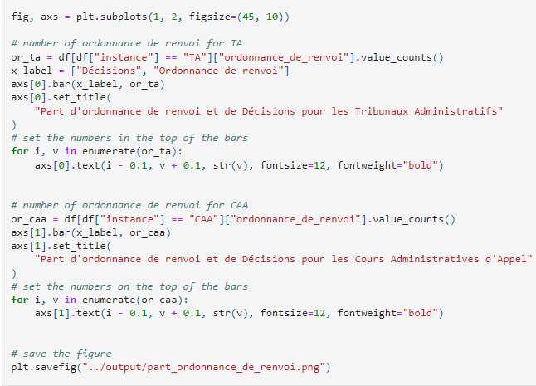
Are there a lot of referrals ?
Unsurprisingly and by design, there are more decisions in the administrative courts than in the courts of appeal. It is interesting to note that a large proportion of decisions are remitted.

Slide 13
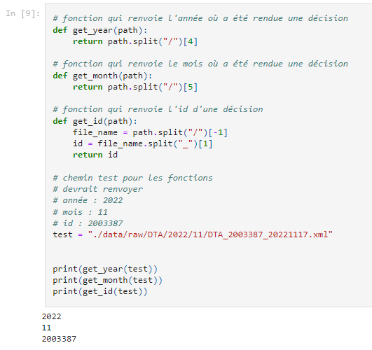

Extracting important data to build a clean csv
For each file, the following data is extracted from the file path:
the year
the month
the decision identifier

Slide 14
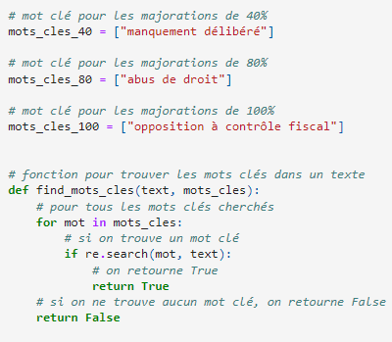
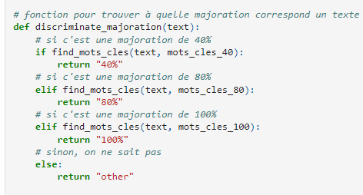
Filtering Data with keywords
« manquement délibéré » - bad faith of the taxpayer
« abus de droit » - Abuse of law
« opposition à contrôle fiscal » - opposition to tax inspection
« 40% », « 80% » and « 100% » tax mark-up

Slide 15
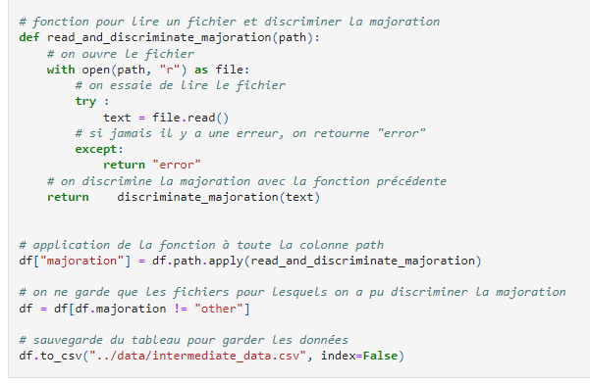
We only keep the files with a tax mark-up

Slide 16
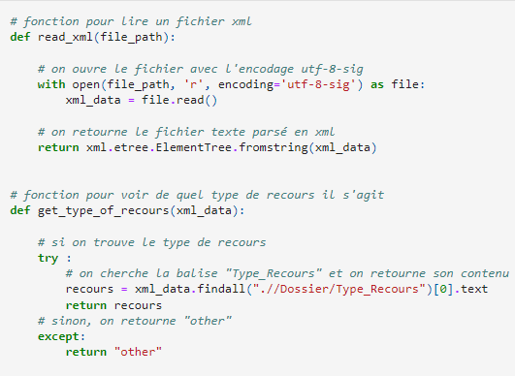
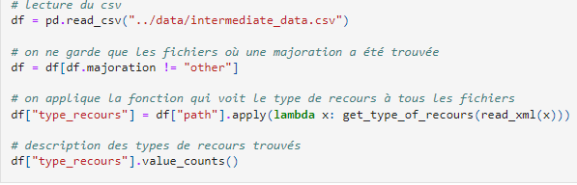
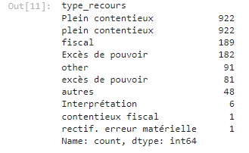
Filtering by type of appeal
It is possible to have a decision that contains the word "abuse of power" but has nothing to do with it (e.g.).
- We remove “Excès de pouvoir” and “excès de pouvoir”

Slide 17
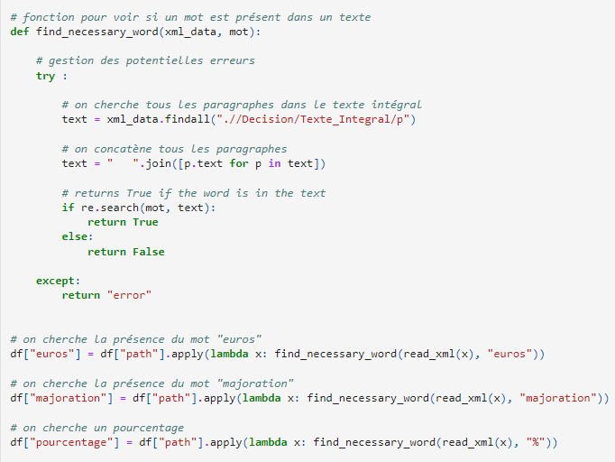
Lastly we verify the mandatory presence of key-words
To check that the previous filters have worked, we look for words that we think are there. We don't use this method to discriminate between decisions, just to make sure we haven't made any mistakes.

Slide 18
Lastly we verify the mandatory presence of key-words
The decisions we kept seem to be the good ones

Slide 19
C. Difficulties
Steps and choices

Slide 20
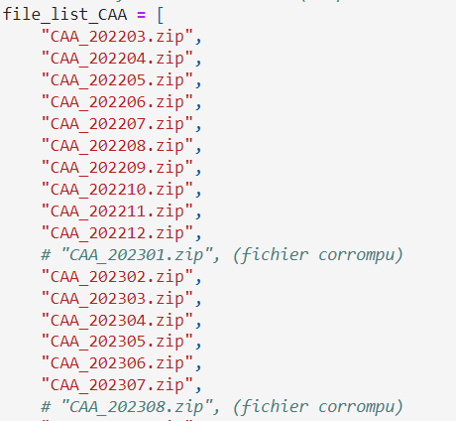
Cleaning bad data
Limited period: decisions available from 2022
Some corrupted files
Decisions VS referral orders ("ordonnances de renvoi")

Slide 21
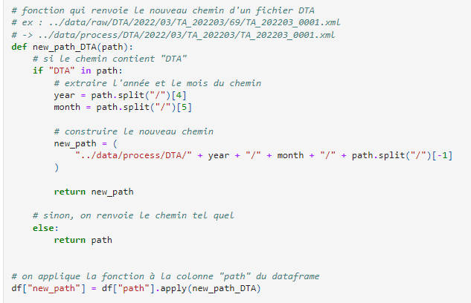
Harmonization
Files were not constructed in the same way, we had to harmonize:
For Administrative Court of Appeal: year/month/decision
For Administrative Court: year/month/court department/decision

Slide 22
D. Results

Slide 23
What are the results ?
With these first rules, we have a corpus of 2,300 decisions.
Predictably, the higher the sanction, the fewer the cases.
We only take decisions, not referral orders.

Slide 24
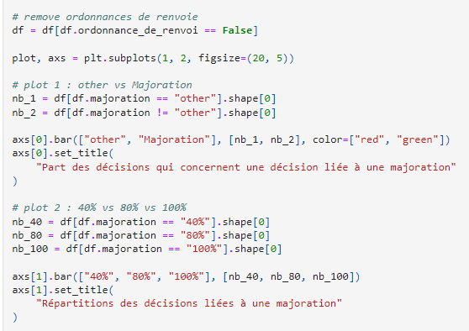
What are the results ?
Share of decisions concerning a decision linked to a mark-up
Breakdown of decisions related to a mark-up

Slide 25
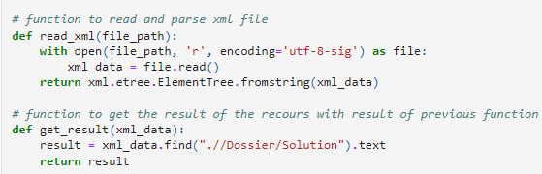
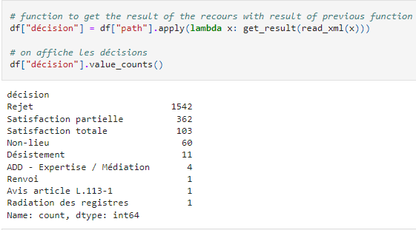
What are the chance of success ?
There are around 600 decisions that have not been rejected, which confirms that the study is interesting

Slide 26
What are the chance of success ?

Slide 27
Can we get more insights from this analysis?
Place where the decision was taken
Type of plaintiff

Slide 28
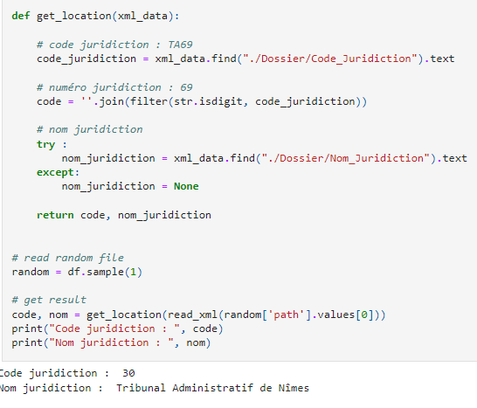
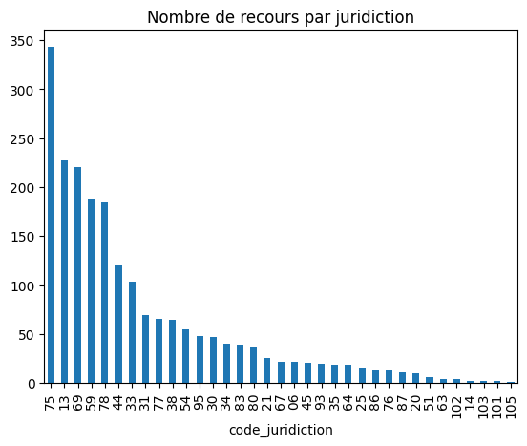
Can we get more insights from this analysis?
We are looking for the place where the decision was taken
→ Paris, Marseille, Lyon, Lille, Versailles,…

Slide 29
Can we get more insights from this analysis?
We are looking for the type of plaintiff: we want to categorize legal entities and private individuals
Find sentences where the type is mentionned
Find the type of plaintiff with recurring expressions
Results

Slide 30
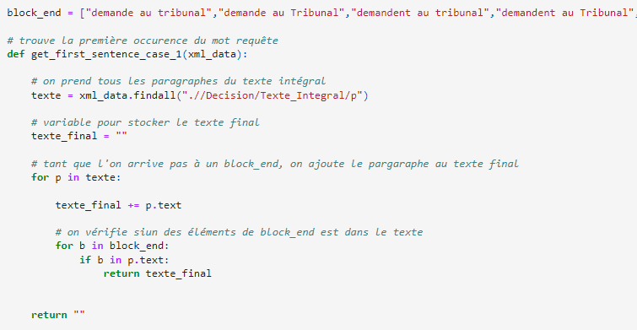
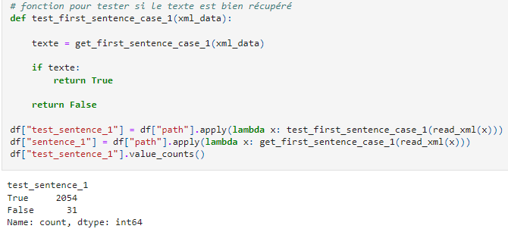
Can we get more insights from this analysis?
Once we have the sentences we need, we try to find the type of the plaintiff in these phrases using regular expressions.

Slide 31
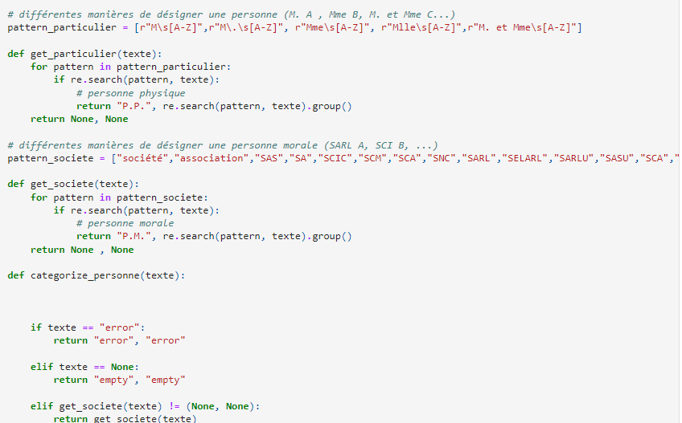

Can we get more insights from this analysis?

Slide 32
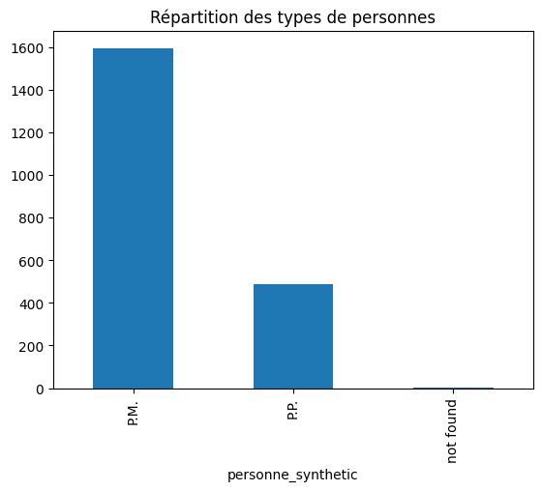
Type of plaintiff - results
Can we get more insights from this analysis?
Type of plaintiff
PM | 1596
PP | 487
PM: Legal entity
PP: Private Individual

Slide 33
What we could have done
We could have continued the analysis with the following questions:
On the basis of the mark-up (is there a greater or lesser chance of seeing the mark-up reduced when the mark-up is 100%?)
Depending on the court in which the cases were handled (Is it more likely that the mark-up will be diminished or removed in Lille than in Lyon?)
Based on whether the case concerned a private individual or a legal entity?
Based on the gender of the individual?

Slide 34


